Slide 1
Sectors of the Hospitality Industry
Teaching and learning material A1.1, A1.2, A1.3, A2.1, A2.2

Slide 2
Welcome and introduction
Introductions
Housekeeping
Health & safety
Phones
Breaks and lunch

Slide 3
Hospitality industry sectors
Aims:
To identify the types of industries within the hospitality sector.
To identify the job roles and progression routes within the industry.
Objectives:
Introduce a broad understanding of the options available for varied career paths.
Provide an overview of the industry and to give options for specialization.

Slide 4
Introduction
Hotels
Restaurants
Sectors of the hospitality industry
Notes:
Main section of industry is HOTELS and RESTAURANTS - show
Another 12 section (maybe ask students to list all they can think of. They may list sub sections and these can be entered into the correct group once next slide is open and discussed – e.g. air steward would come into travel services).
Student lists on flipchart or smart board

Slide 5
Introduction
Hotels
Restaurants
Hospitality services
Gambling
Events
Pubs, bars & nightclubs
Sectors of the hospitality industry
Travel services
Contract catering
Tourist services
Membership clubs
Visitor attractions
Hostels
Self catering
Holiday parks
Notes:
Compare student lists to actual. They may list sub sections and these can be entered into the correct group once next slide is open and discussed – e.g. air steward would come into travel services).
Expand on each heading in discussion with examples, e.g. Events – film location, Glastonbury, wedding.
All sections can include food and beverage in some form.
Almost all do.
Some directly, some as an add on – ask for examples
travel services?
casinos?
We will start by looking specifically at Food and beverage and then accommodation.

Slide 6
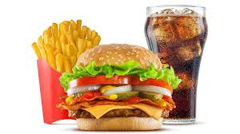
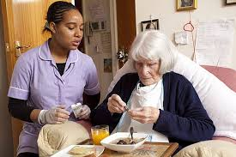
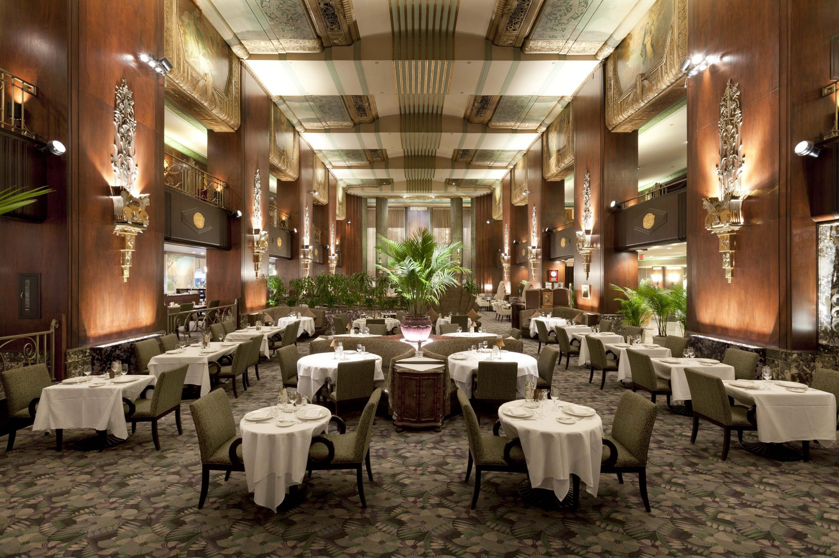
Commercial
It is the reason for the operation being there:
Hotels
Hostels
Restaurant
Service
It is there because people are there:
Hospital
Prison
Colleges
Care home
Notes:
What is the difference between COMMERCIAL and SERVICE?
Is the operation aimed at profit?
Must the operation keep to a specific budget but not necessarily make a profit?
Also, for both groups:
Does the operation have restricted customer base?
(e.g. catering on a train is only available to travelers, patients in a hospital).

Slide 7
Food and beverage: sales
Notes:
Why does a quick service outlet serve 3 times as many meals as a restaurant but only take a little more in revenue?
What differences may there be in the operational costs for a quick service and a restaurant? List -
more service staff to pay wages
more expensive décor and furniture
customers stay longer in restaurant, (reduce turnover of covers)
etc

Slide 8
Commercial outlets
Takeaways
Fast-food outlets
Popular catering
Mainstream catering
Fine dining
Pubs and bars
Notes:
Expand on each group to give examples of outlets – perhaps locally known
Takeaways (fish and chip shops, sandwich bars and ethnic outlets such as kebab shops) –very quick service – often now delivered to your home.
Fast-food outlets: in a specialised environment – especially kitchen- very quick service.
Popular catering (includes cafés and coffee shops including those found in retail stores). Cafés focus on food, coffee shops on beverages.
Mainstream catering: ethnic and themed – usually medium to high prices with good levels of service.
Fine dining: high levels of skilled service both in the kitchen and front of house.
Pubs and bars: Sports bars: with large-screen TV’s showing live sport, especially football matches.
Cocktail bars: have sophisticated décor and a cocktail menu. Often doormen enforce
a dress code for customers, such as no trainers or jeans.
Wine bars: a little like continental coffee bars. They offer a wider choice of drinks
than the traditional pub, such as teas and coffees. This type of bar attracts a wider
clientele, such as single women, because of the ambience created.
Family-friendly pubs: with an outside playground and sometimes one inside. Food is
particularly important for these pubs.
What can you expect from each in terms of :
menu
cost
ambience
speed of service

Slide 9
Service outlets
Hospitals
Prisons
Care homes
Schools
Social enterprise
Notes:
What type of service could be expected at each? (e.g. self service at prison and schools, waiting service in hospital).
What menu considerations would there be in terms of
diet
health
cost
speed of service
special requirements

Slide 10
Accommodation
Hotels
5* to low cost
Motels & lodges
Guest houses, B&B
Air BnB
Hostels
Holiday centres
Self catering
Membership clubs
Conference centres
Notes:
Complete chart of facilities expected at each.
Use each of the types of accommodation on Y axis and services expected on X axis
own room meals. licensed bar. Entertainment. etc
Hotel
Motel
Guest house
Air BnB
Hostel
Holiday centre
Self catering
Membership club
Conference centre
Include relevant suggestions from students

Slide 11
Some routes into hospitality

Slide 12
What areas can I work in?
Hospitality jobs are available in:
contract catering/food service management
hotels
leisure attractions
pubs, bars and nightclubs
restaurants and coffee shops
self-catering and holiday centres.
Events careers include:
conference management
corporate days out and product launches
entertainment and sporting events
exhibition management
fundraising
weddings and parties.
What skills to employers want?
You will need:
a people-centred approach and customer service skills
the ability to work in a team
flexibility, a willingness to work unsocial hours and stamina
confidence, a persuasive approach and organisational skills
language skills.

Slide 13
Hospitality routes
Restaurant
Hotel
Visitor attractions
Pubs and clubs
Gaming
Tourism
Management
Holiday centres
Events
Notes:
Flipchart or smartboard:
Job roles within restaurant – e.g.
chef and assistants
Maitre d
waiting staff
cashier
manager
menu planning

Slide 14
Restaurant this ranges from ‘top end’ to ‘quick service’. Includes coffee shops that are expanding faster than any other with the industry KITCHEN
As head chef (also known as chef de cuisine), you'll run a kitchen, create menus and manage the budget.
As sommelier you will be .knowledgeable wine professional, working in fine restaurants, who specializes in all aspects of wine service as well as wine and food pairing.
Chef, sous chef,
Sommelier.
Notes:
The next slides are some examples of jobs within the industry. There are handouts for all the areas.
Suggest these are discussed and students research the remainder in groups? To identify roles and jobs in which they are potentially interested

Slide 15
Restaurant front of house
Barista
Maitre d
Customer server
The front of house staff are the diplomats of the organisation.
From the Maître D’s who are the first point of contact of the guests and patrons when entering a restaurant or any other dining establishment to the barista, cashier and waiting staff.

Slide 16
Hospitality routes
Restaurant
Hotel
Visitor attractions
Pubs and clubs
Gaming
Tourism
Management
Holiday centres
Events
Notes:
Flipchart or smartboard:
Job roles within hotel:
Management
reception
housekeepers
customer care & service
restaurant
bar
conference facilities
etc

Slide 17
Hospitality routes
Restaurant
Hotel
Visitor attractions
Pubs and clubs
Gaming
Tourism
Management
Holiday centres
Events
Notes:
Flipchart or smartboard:
Job roles within visitor attractions:
housekeepers
guides
reception
information
retail & cashiers
etc.

Slide 18
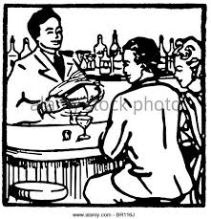
Hospitality routes
Restaurant
Hotel
Visitor attractions
Pubs and clubs
Gaming
Tourism
Management
Holiday centres
Events
Notes:
Flipchart or smartboard:
Job roles within pubs and clubs
licensed bar
housekeeper
stock control
customer care & service
legal requirements

Slide 19
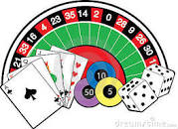
Hospitality routes
Restaurant
Hotel
Visitor attractions
Pubs and clubs
Gaming
Tourism
Management
Holiday centres
Events
Notes:
Flipchart or smartboard:
Job roles within gaming industry
croupier
customer service
security
cashier
food and beverage
management
legal requirements

Slide 20
Hospitality routes
Restaurant
Hotel
Visitor attractions
Pubs and clubs
Gaming
Tourism
Management
Holiday centres
Events
Notes:
Flipchart or smartboard:
Job roles within tourism:
customer service
guide
food and beverage
cashier
interpreter

Slide 21
Hospitality routes
Restaurant
Hotel
Visitor attractions
Pubs and clubs
Gaming
Tourism
Management
Holiday centres
Events
Notes:
Flipchart or smartboard:
Job roles within food and drink management
Administration

Slide 22
Hospitality routes
Restaurant
Hotel
Visitor attractions
Pubs and clubs
Gaming
Tourism
Management
Holiday centres
Events

Slide 23
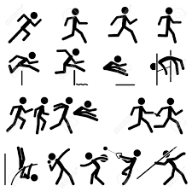
Hospitality routes
Restaurant
Hotel
Visitor attractions
Pubs and clubs
Gaming
Tourism
Management
Holiday centres
Events

